Slide 1

Portfolio Website
Task - 1

Slide 2
Portfolio website :
LMS Username | Name | Batch
2115a110 | HARINI J | A1
2115a111 | HASEENA A | A1
2115a118 | NISHANTHI M | A1
2115a135 | SRUTHI SAILA G | A1

Slide 3
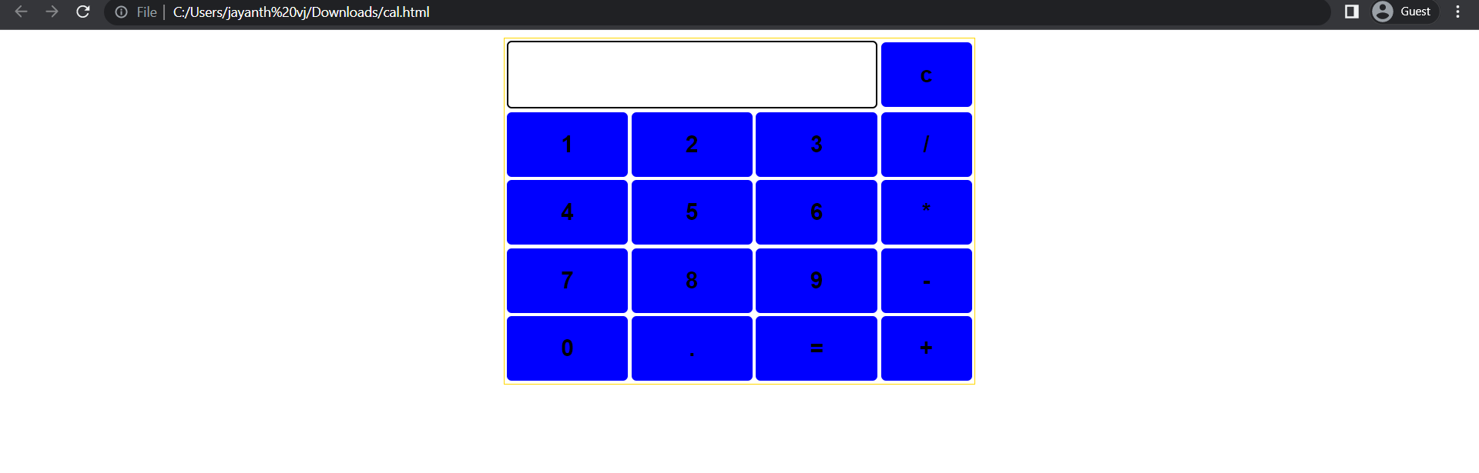
Past calculator output here

Slide 4
Portfolio website :
The portfolio web design project aims to create a visually appealing and user-friendly website that showcases the client's work, skills, and accomplishments.
The website will serve as a platform to display the client's portfolio and provide information about their professional background

Slide 5
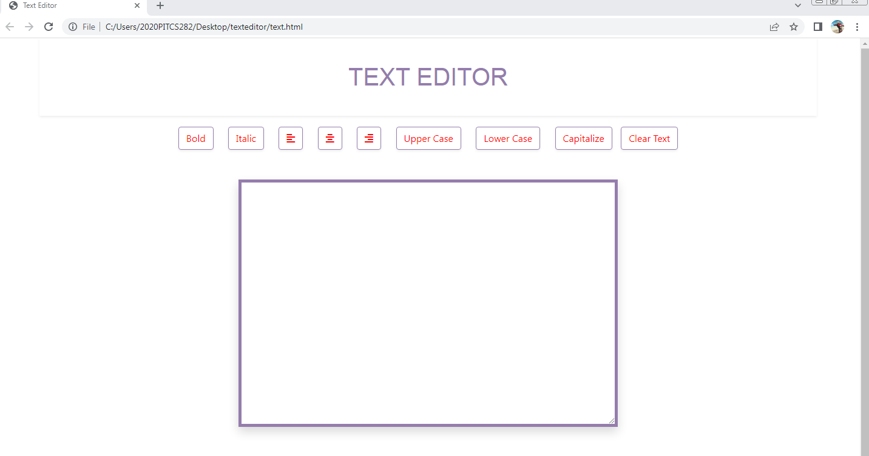
Past text editor output here

Slide 6
Assessment Parameter
Setup Project for Calculator project
Setup basic structure of text-editor project
Create a main component with the outer structure of calculator
Check-List
Create main component with all feature buttons
Create a button component with on click handler
Create a json object to store data for text editor
Create a ` evaluateExpresion` function to evaluate value
Push both code to github

Slide 7
E-Commerce Github
https://github.com/sailaganesh/saila.git.git

